Slide 1
Heart Failure Analysis
Using Classification Algorithms

Slide 2
Problem Understanding
Predict heart failure outcomes using machine learning algorithms.
Objective: Analyze clinical features to identify risk factors for heart failure-related deaths.
Dataset: Medical records of 299 patients with 13 clinical features collected during follow-up period.
Importance: Early detection and personalized treatment strategies can improve patient outcomes.

Slide 3
Solution
Utilize classification algorithms for heart failure prediction.
Implement AutoViz for automated exploratory data analysis (EDA).
Evaluate model performance using confusion matrix and relevant metrics.
Translate predictive insights into actionable recommendations for patient management.

Slide 4
Benefits
Early Detection: Identify heart failure risks before adverse outcomes occur.
Personalized Treatment: Tailor interventions based on individual patient profiles.
Resource Optimization: Allocate healthcare resources more efficiently.
Improved Outcomes: Enhance patient outcomes through data-driven decision-making.

Slide 5
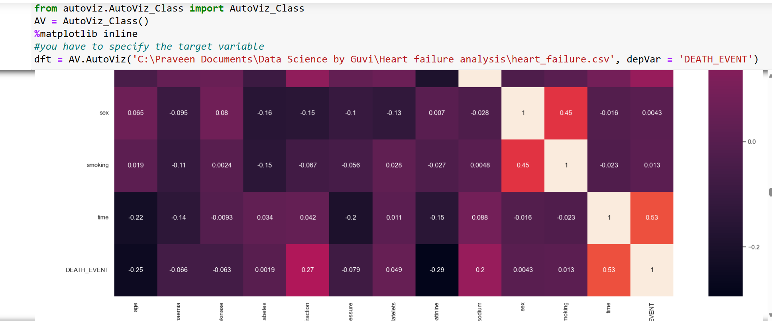
Exploratory Data Analysis (EDA)
AutoViz: Generate visualizations of clinical feature distributions.
Identify Trends: Analyze age, gender, and clinical variables for insights.
Missing Values: Handle missing data appropriately for robust analysis.
Outlier Detection: Identify outliers and their impact on predictive models.

Slide 6
Descriptive Analysis
Class Distribution: Analyze distribution of target variable 'DEATH_EVENT'.
Imbalance Check: Assess imbalance between heart failure and non-heart failure cases.
Feature Correlation: Investigate correlations between clinical features and outcomes.
Data Preprocessing: Handle categorical variables and scale numerical features.

Slide 7
Diagnosis Analysis
Correlation Heatmap: Visualize feature correlations with target variable.
Feature Importance: Rank features based on their impact on heart failure prediction.
Domain Knowledge: Incorporate medical expertise to interpret feature importance.
Interpretation: Discuss clinical implications of significant features.

Slide 8
Classification Algorithms
Random Forest: Ensemble learning for robust predictions.
Logistic Regression: Linear model for probability estimation.
KNN: Nearest neighbors algorithm for similarity-based classification.
Decision Tree: Hierarchical decision-making for interpretability.
SVM: Support vector machines for complex decision boundaries.
Naive Bayes: Probabilistic classifier based on Bayes' theorem.

Slide 9
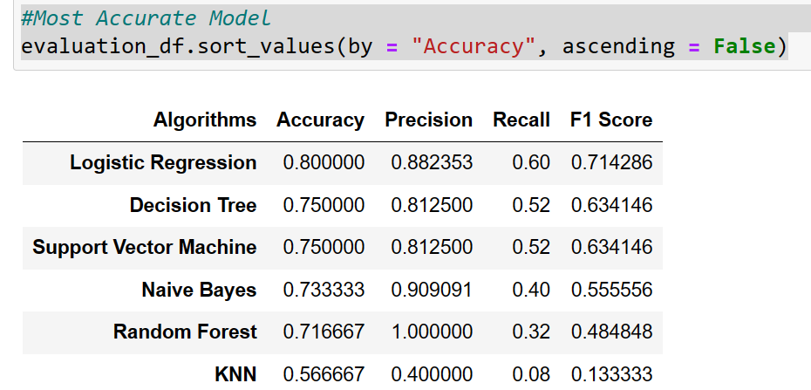
Model Comparison
Accuracy: Evaluate accuracy of each classification algorithm.
Precision: Assess precision of positive predictions.
Recall: Measure ability to detect true positive cases.
F1 Score: Balance between precision and recall for binary classification.
Visualize: Compare performance metrics across different algorithms.

Slide 10
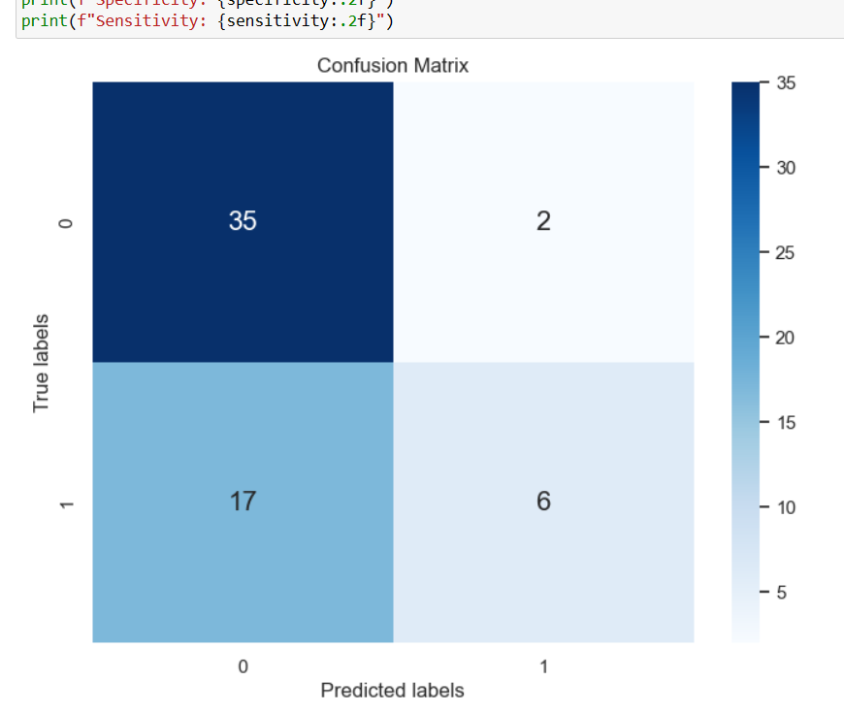
Confusion Matrix
True Positives: Actual heart failure cases correctly predicted.
True Negatives: Non-heart failure cases correctly predicted.
False Positives: Non-heart failure cases incorrectly predicted as heart failure.
False Negatives: Heart failure cases incorrectly predicted as non-heart failure.
Calculate: Additional performance metrics like specificity and sensitivity.

Slide 11
Predictive Analysis
Patient Risk Assessment: Predict heart failure outcomes for individual patients.
Early Intervention: Intervene early based on predictive insights.
Treatment Planning: Tailor treatment strategies based on predicted risk.
Patient Monitoring: Continuously monitor patient outcomes for proactive care.

Slide 12
Prescriptive Analysis
Treatment Recommendations: Offer personalized treatment recommendations based on predictive insights.
Patient Education: Educate patients about heart failure risks and preventive measures.
Care Coordination: Coordinate care among healthcare providers for comprehensive management.
Follow-Up: Schedule regular follow-up visits to monitor patient progress.

Slide 13
Conclusion
Summary: Recap key findings and insights from heart failure analysis.
Importance: Highlight the significance of machine learning in medical research and patient care.
Future Directions: Encourage further research and validation of predictive models.

